Slide 1
Dental Clinic Management System (DCMS)
(proposal)
Rashida Bibi 2021-GCUF- 073371
Saba Akhtar 2021-GCUF- 058551
Arslan Ali 2021-GCUF- 058613
Supervised By: Prof. Yasir Arfat

Slide 2
Project Overview
The Dental Clinic Management System (DCMS) is a web-based solution designed to streamline dental clinic operations, including appointment scheduling, patient records management, billing, and treatment tracking.
Purpose:
A web-based solution to streamline dental clinic operations.
Key Features:
Appointment scheduling, patient records management, billing, and treatment tracking.

Slide 3
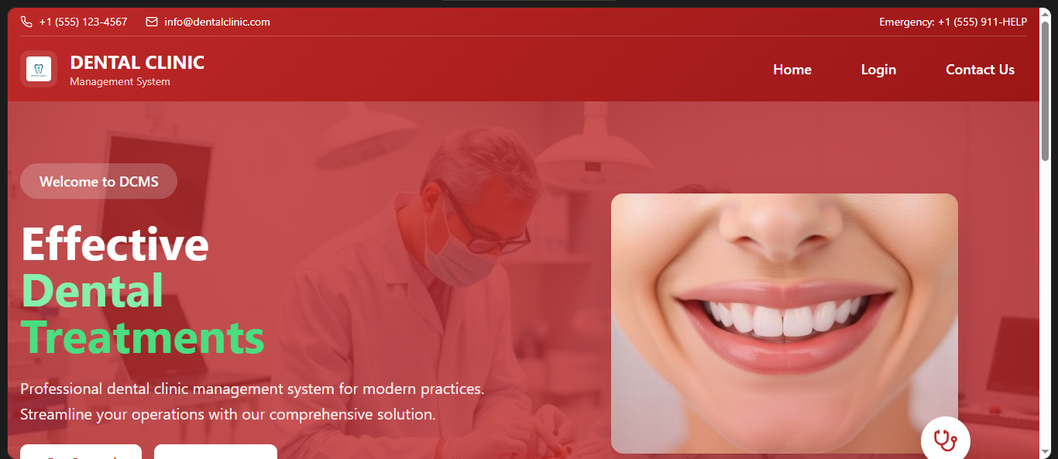

Slide 4

Login Page

Slide 5
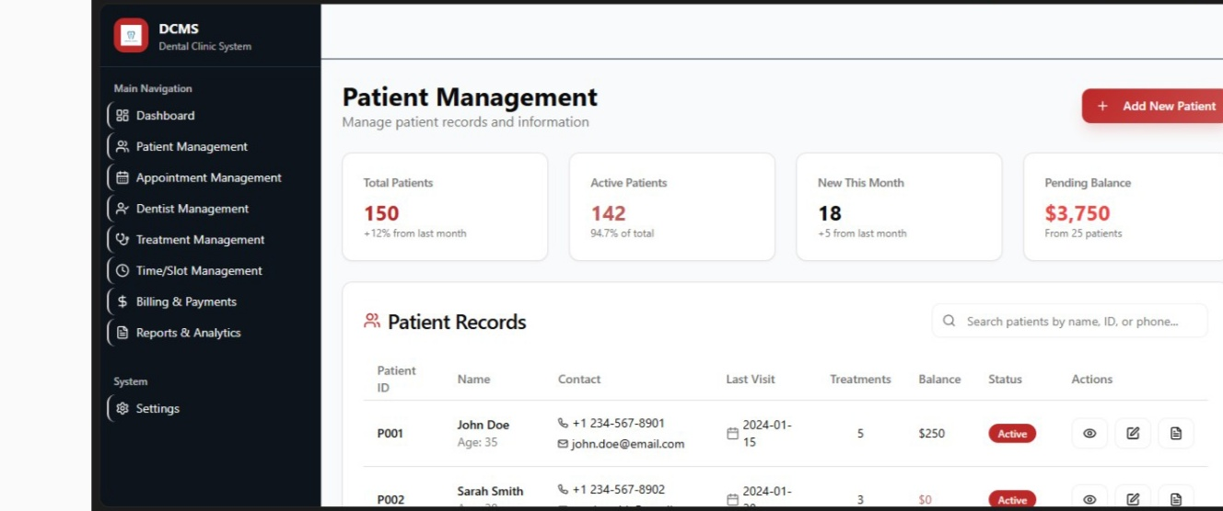
Patient Management

Slide 6
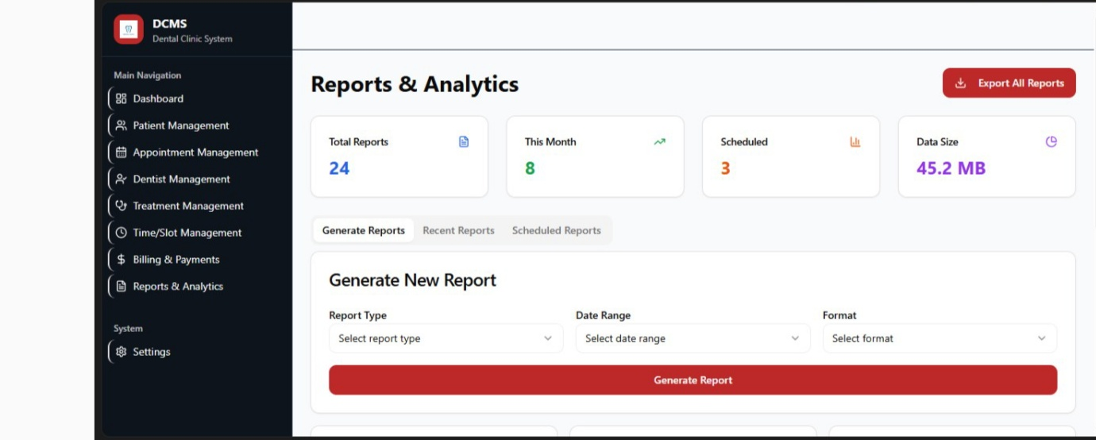
Report & Analysis

Slide 7
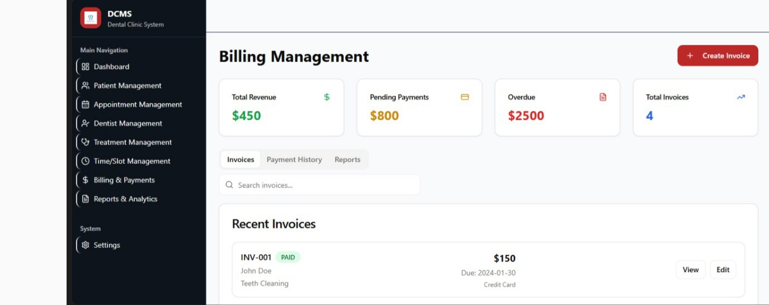
Billing management

Slide 8
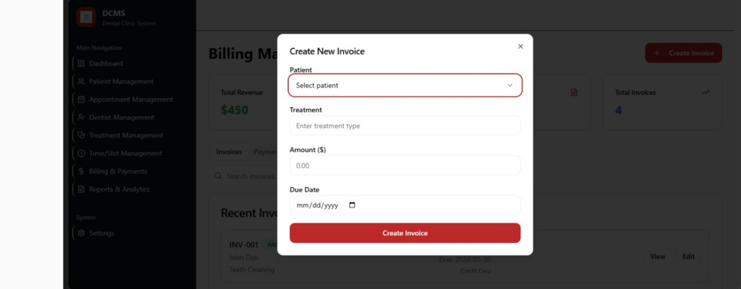
Invoice

Slide 9
The Problem
Current Challenges:
Manual record-keeping leading to inefficiencies.
Appointment conflicts, data loss, and delays in patient care.
Need for an efficient, automated, and secure solution.

Slide 10
Objectives
Automate Patient Appointment Scheduling
Maintain Secure Digital Patient Records
Simplify Billing & Treatment History Tracking
Improve Clinic Workflow & Efficiency
Limitations:
Requires internet connectivity.
Initial learning curve for staff

Slide 11
Scope of the Project
Included:
Patient registration & appointment booking.
Treatment records & history.
Billing & payment management.
Doctor & staff management.
Excluded:
Online telemedicine consultation.
AI-based diagnosis suggestions..

Slide 12
Technology Stack
Frontend: React.js
Backend: Node.js
Database: MySQL
Hosting: AWS / Firebase
Security: JWT Authentication

Slide 13
Expected Challenges & Risks
Challenges:
Data Privacy & Security Compliance (e.g., HIPAA)
User Adoption & Training
Integration with Existing Systems
Potential Downtime & Maintenance Issues

Slide 14
Conclusion
Key Benefits of DCMS:
Increased efficiency and accuracy.
Enhanced patient experience and satisfaction.
Reduced operational costs and errors.
Call to Action:
Ready to proceed with the development of the system.

Slide 15
Reference
American Dental Association. (n.d.). Practice management.
Bansal, A., & Singh, S. (2019). A Review of Dental Clinic Management Systems. International journal of Computer Applications .

